Slide 1
‘SentTWEET’
Sentimental Analysis - TWITTER

Slide 2
THE SOCIAL IMPACT
Microblogging today has become a very popular communication tool among Internet users.
Millions of users share opinions on different aspects of life everyday in popular websites such as Twitter, Tumblr and Facebook.
Spurred by this growth, companies and media organisation are increasingly seeking ways to mine these social media for information about what people think about their companies and products.

Slide 3
WHAT IS SENTIMENT ANALYSIS?
Sentiment Analysis is the process of ‘computationally’ determining whether a piece of writing is positive, negative or neutral. It’s also known as opinion mining, deriving the opinion or attitude of a speaker.

Slide 4
WHY SENTIMENT ANALYSIS?
Business: In marketing field companies use it to develop their strategies, to understand customers’ feelings towards products or brand, how people respond to their campaigns or product launches and why consumers don’t buy some products.
Politics: In political field, it is used to keep track of political view, to detect consistency and inconsistency between statements and actions at the government level. It can be used to predict election results as well!
Public Actions: Sentiment analysis also is used to monitor and analyse social phenomena, for the spotting of potentially dangerous situations and determining the general mood of the blogosphere.

Slide 5
!!WHY TWITTER!!
With over 500+ million Tweets (short text messages) per day, Twitter is becoming a major source of information.
Twitters audience varies from regular users to celebrities, company representatives, politicians, and even country presidents. Therefore, it is possible to collect text posts of users from different social and interests groups.
Tweets are small in length, thus less ambiguous.
Tweets are unbiased in nature.

Slide 6
APPROACH
Fetching Tweets
Using Python and NLP for Analysis
Display output in the form of positive, negative and neutral percentage

Slide 7
WORKFLOW
Installation:
Tweepy: tweepy is the python client for the official Twitter API.
TextBlob: textblob is the python library for processing textual data.
NLTK corpora: Corpora is nothing but a large and structured set of texts.

Slide 8
WORKFLOW
Authentication:
In order to fetch tweets through Twitter API, one needs to register an App through their twitter account
Authorize twitter API client:
First of all, we create a TwitterClient class. This class contains all the methods to interact with Twitter API and parsing tweets. We use __init__ function to handle the authentication of API client.
Make a GET request to Twitter API to fetch tweets for a particular query:
In get_tweets function, we use:
fetched_tweets = self.api.search(q = query, count=count)

Slide 9
WORKFLOW
Parse the tweets. Classify each tweet as positive, negative or neutral.
In get_tweet_sentiment we use textblob module.
analysis = TextBlob(self.clean_tweet(tweet))

Slide 10
WORKING OF TextBlob
TextBlob is actually a high level library built over top of NLTK library. First we call clean_tweet method to remove links, special characters, etc. from the tweet using some simple regex. Then, as we pass tweet to create a TextBlob object, following processing is done over text by textblob library.
Tokenize the tweet ,i.e split words from body of text.
Remove stopwords from the tokens.(stopwords are the commonly used words which are irrelevant in text analysis like I, am, you, are, etc.)

Slide 11
WORKING OF TextBlob
Do POS( part of speech) tagging of the tokens and select only significant features/tokens like adjectives, adverbs, etc.
Pass the tokens to a sentiment classifier which classifies the tweet sentiment as positive, negative or neutral by assigning it a polarity between -1.0 to 1.0 .

Slide 12
HOW SENTIMENT CLASSIFIER IS CREATED
TextBlob uses a Movies Reviews dataset in which reviews have already been labelled as positive or negative.
Positive and negative features are extracted from each positive and negative review respectively.
Training data now consists of labelled positive and negative features. This data is trained on a Naive Bayes Classifier.
Then, we use sentiment.polarity method of TextBlob class to get the polarity of tweet between -1 to 1.

Slide 13
POLARITY ALGORITHM
if analysis.sentiment.polarity > 0:
return 'positive'
elif analysis.sentiment.polarity == 0:
return 'neutral'
else:
return 'negative‘
Finally, parsed tweets are returned. Then, we can do various type of statistical analysis on the tweets. For example, in above program, we tried to find the percentage of positive, negative and neutral tweets about a query.

Slide 14
NAÏVE BAYES CLASSIFIER
It is a classification technique based on Bayes’ Theorem with an assumption of independence among predictors. In simple terms, a Naive Bayes classifier assumes that the presence of a particular feature in a class is unrelated to the presence of any other feature.
Naive Bayes model is easy to build and particularly useful for very large data sets. Along with simplicity, Naive Bayes is known to outperform even highly sophisticated classification methods.

Slide 15
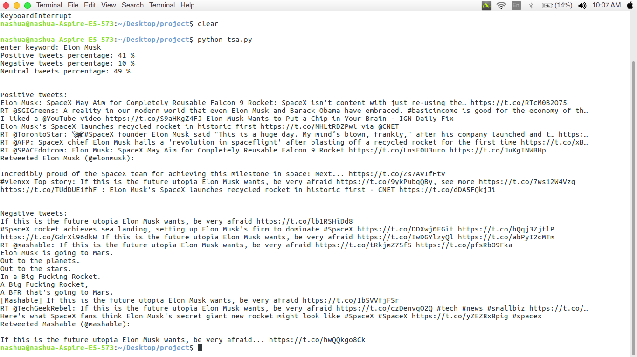
OUTPUT

Slide 16
APPLICATIONS
Applications to Review
Related Websites-Movie Reviews, Product Reviews etc.
Applications as a Sub-Component Technology
-Detecting antagonistic, heated language in mails, spam detection, context sensitive information detection etc.
Applications in Business and Government Intelligence
Knowing Consumer attitudes and trends
Applications across Different Domains
Knowing public opinions for political leaders or their notions about rules and regulations in place etc.

Slide 17
CONCLUSION & FUTURE SCOPE
Conclusion:-
We conclude that using different NLTK classifier it is easier to classify the tweets and more we improve the training data set more we can get accurate results.
Future Work:-We look forward to use bigger dataset to improve the accuracy,considering the emoticons and internationalization.

